Slide 1

LEARN, BUILD AND GROW - WITH A COMMUNITY IN YOUR POCKET
Notes:
Color Scheme, Look at brand color generator. Stick to colors. Consult with Eiman.

Slide 2
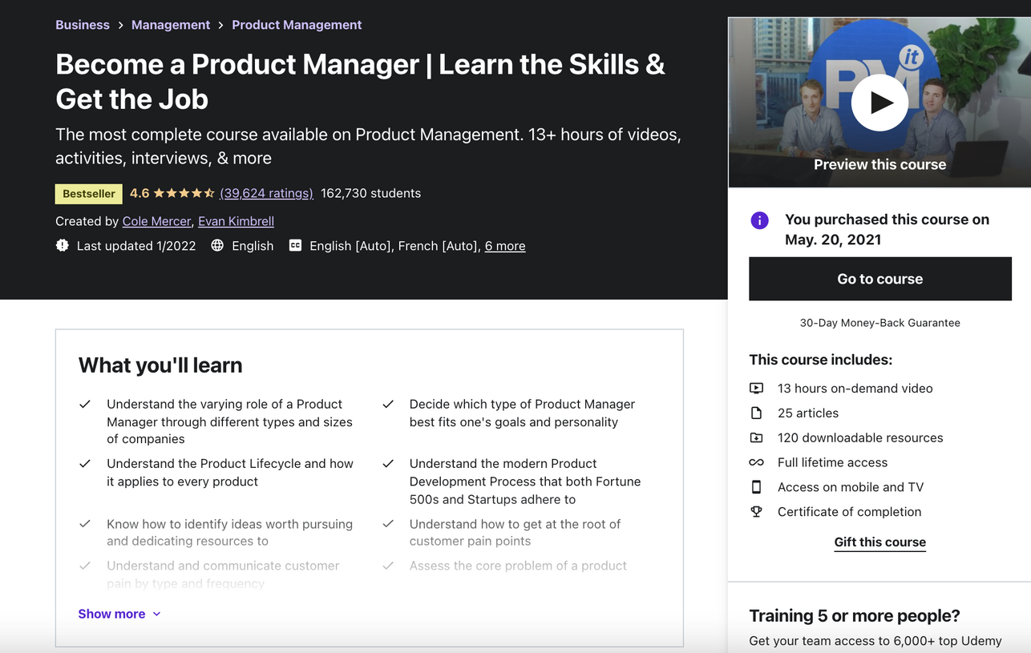
In March 2021, I joined an online course on Udemy...
The content was great, however I got stuck and did not finish the course.
Notes:
Color Scheme, Look at brand color generator. Stick to colors. Consult with Eiman.

Slide 3
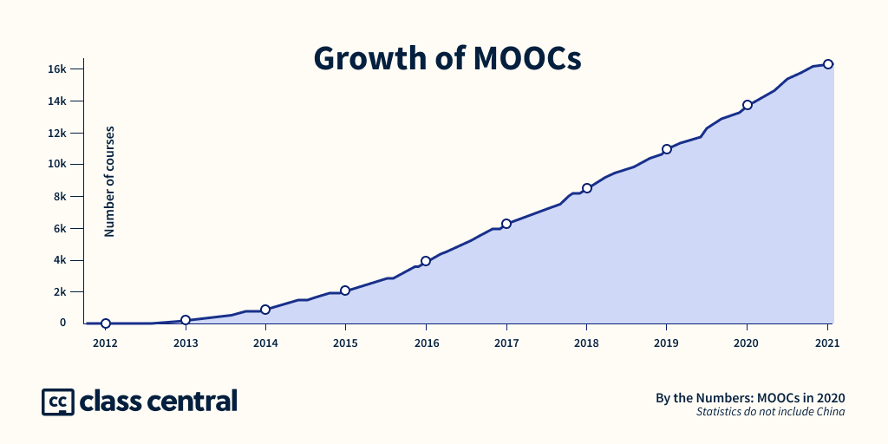
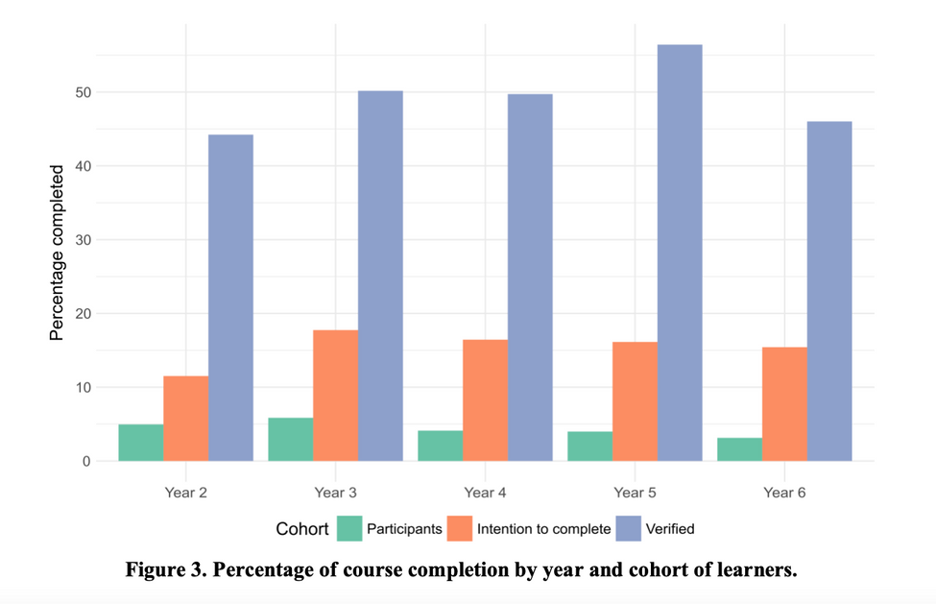
And I am not alone.
By the end of 2020, 180 million learners joined 16.3 thousand courses.
MOOCs achieved a completion rate of 10%.
Notes:
Color Scheme, Look at brand color generator. Stick to colors. Consult with Eiman.

Slide 4
Education is moving online, but no model accommodates online learning success.
Lack of engagement and community.

Slide 5
Solution
UNPACKAI
Build an online digital tribe and space for lifetime learners
to build the infrastructure and economy for decentralised learning communities and achieve an average graduation rate of 90%.

Slide 6


Lack of engagement
Student learns as part of an active and supportive learning community
Every interaction and contribution to the community is measured and incentivised by platform tokens, rewards and ranks.

Slide 7
From learning to contribution
Students can engage beyond classes as...
Mentor
Course Builder
Platform Builder
Community Builder
...and create and scale their own learning community.

Slide 8
Student-Mentor Growth Lift🚀
Senior Mentors
Blockchain 301
Scaling up your tech application
Mentors are Grads of Blockchain 301
Blockchain 201
Project Deep Dive
Mentors are Grads of Blockchain 201
Ideal for non-coders!
Blockchain 101
Hands-on skills for business professionals

Slide 9
Real life impact.
All achievements and performance-related data points generate a blockchain based profile to create an immutable, data-driven and verifiable CV.

Slide 10
Progress
UNPACKAI
Thus far, we have created learning communities with a wealth of courses around...
AI & Machine Learning
Blockchain
Python
Conducted 20 programs with a community size of 400 people and achieved a graduation rate of 70%.

Slide 11
Me
UNPACKAI
I myself successfully graduated from the course, and learned more about AI & Machine Learning, and Python than I ever did on any other platform within a short amount of time.
At last, I was also offered a job as an Data Product Manager.

Slide 12
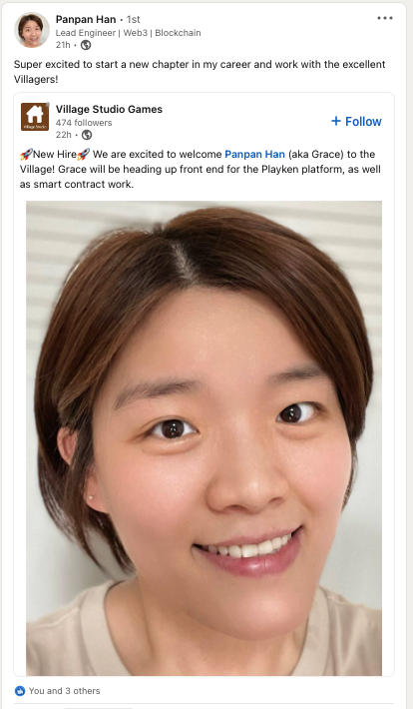
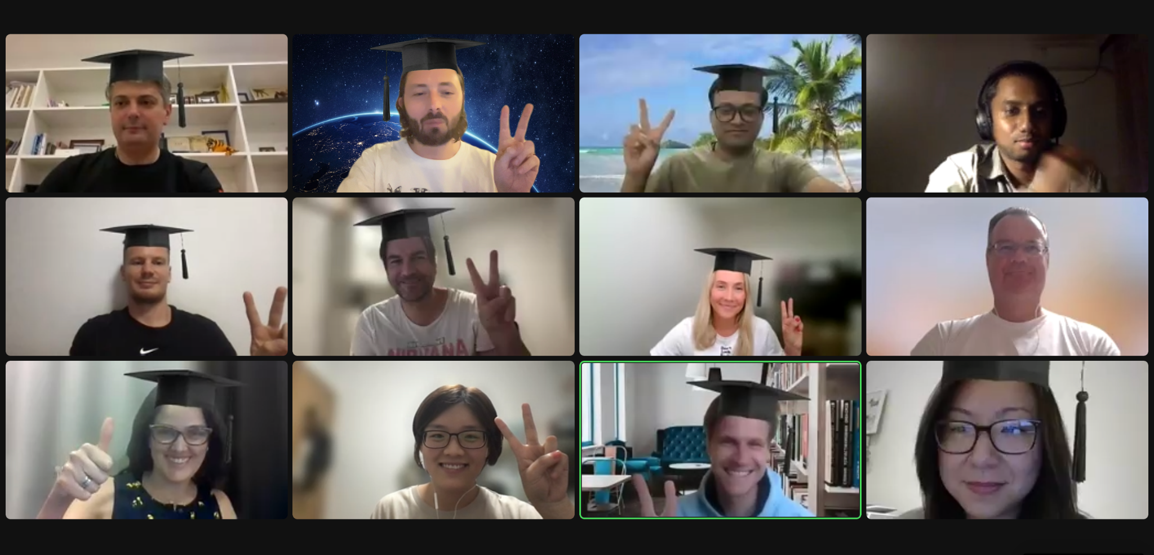
Blockchain cohort # 2 Graduation🎓🎆

Slide 13
Course Kick-Off
The power of Blockchain: Discover NFTs, DeFi, DAOs

Slide 14
Introductions

Slide 15
Introduction
Everyone has 2 minutes.
What’s your name?
What is your current occupation?
Why are you interested in Blockchain?
Verbal Commitment:
“I am going to commit at least 10 hours per week for this Bootcamp”.

Slide 16
Affiliate Programs in unpack community
🧑🏻‍🤝‍🧑🏽Bring Your Friend
10% off for the current or future programs if your friend signs up for any unpack course. Discounts can be added 10% + 10 % +... = free attendance
🧑‍ Be unpack Ambassador
Benefits:
Receive 10% from course price as the direct payback every time you bring a new person to unpack programs. The money will be sent on the last day of every month
Receive exclusive unpack T-shirt or hoodie or mug if you are located in China
Be featured on social media to create your own voice in the tech and educational space

Slide 17
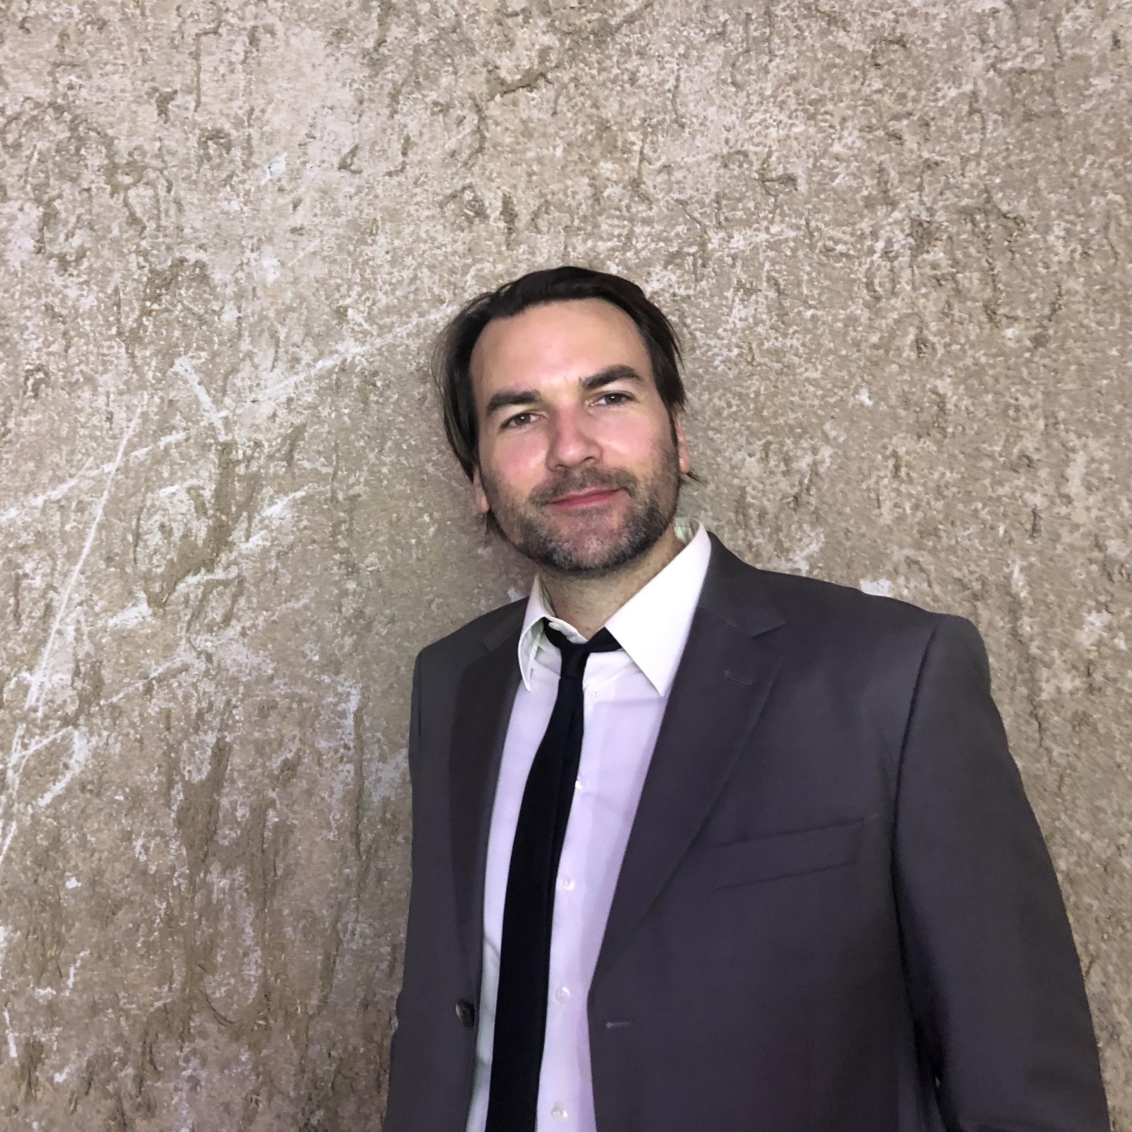
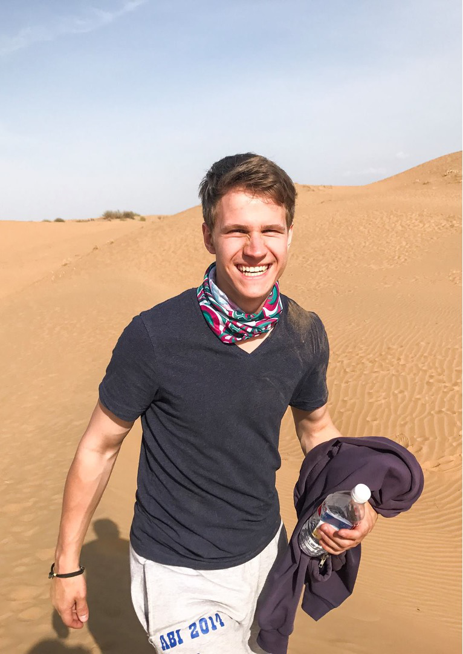
Our course creators
Dirk is a Data Scientist with an academic background in economics and sociology and experience in survey research.
Originally from Germany, Dirk came in 2018 to China. He works as a Data Analyst (official) and “tech-guy” (unofficial) for a medium-sized Shanghai based e-commerce company.
Dirk is interested in modern society topics be it transformational change, evolution of democracies, digital transformation, or philosophy in general.
John is an AI & Blockchain entrepreneur in China with an extensive background in tech.
He is currently responsible for User Growth and Product at a blockchain startup, thats focuses on building an AI-driven price oracle for NFTsm, and has co-founded unpack.
He has developed his own blockhain applications, and has experience in solidity, the programming language of the ethereum blockchain.

Slide 18
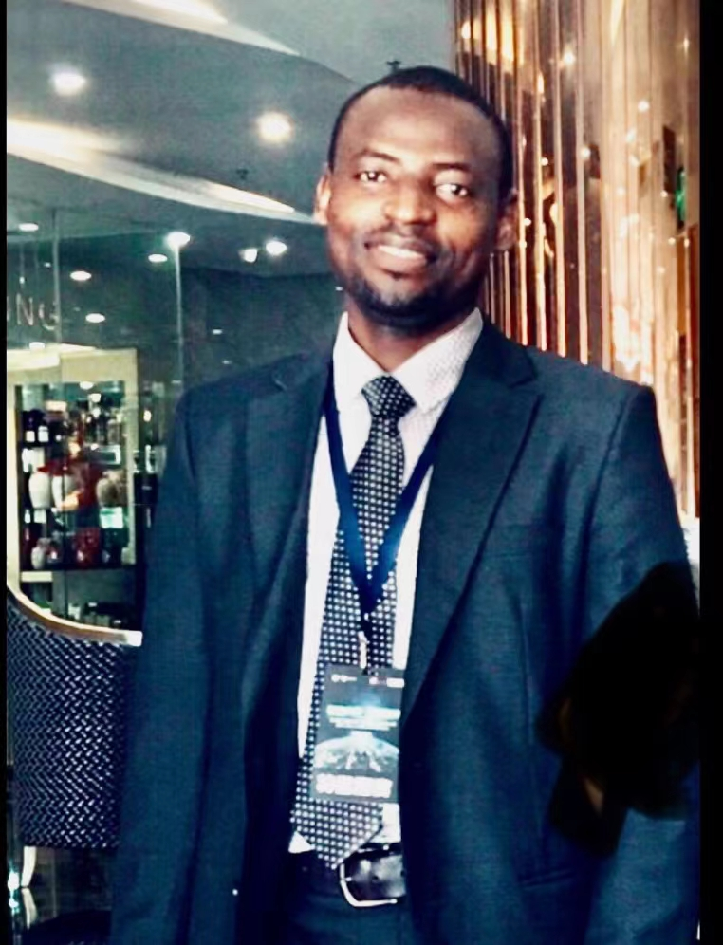
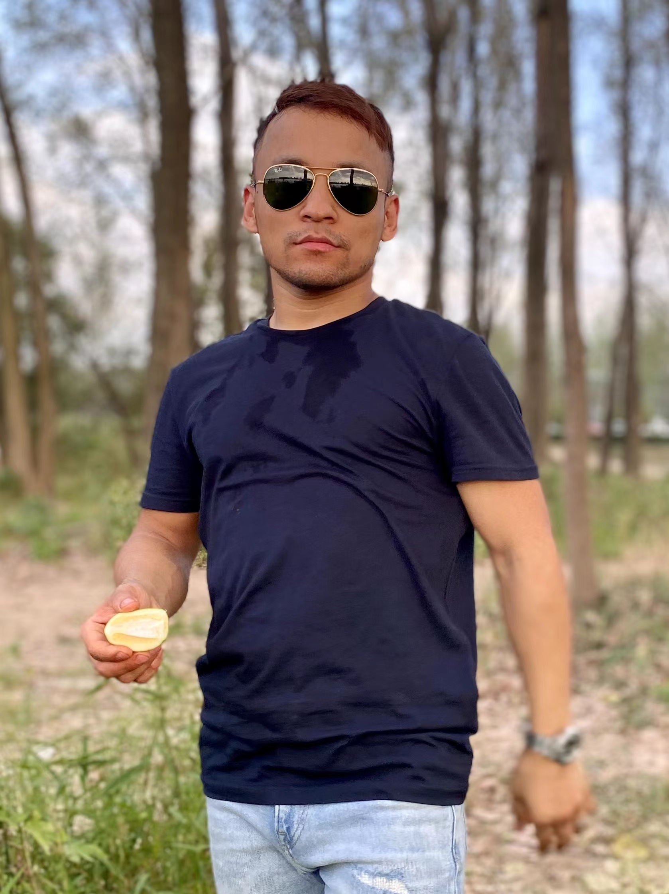
Our course mentors
Abba is a tech entrepreneur based in China.
He got his PhD in computer software and theory from Peking University. He has extensive experience in Blockchain technology.
He worked with the WeBlock foundation as an adjunct CTO, where he consulted and advised on many blockchain projects. Currently, he is focusing on Gamify, NFT, and Web 3.
Ryan came to China in 2010. He graduated from a Chinese university as an aeronautical engineer. He lives in Nanjing.
He first came across Bitcoin and blockchain technology in 2017.
He is intrigued by the potential of Ethereum, decentralized finance and NFTs. He is also involved in an NFT project.
He has knowledge of Javascript, Python, Solidity and HTML.

Slide 19
Expectations

Slide 20
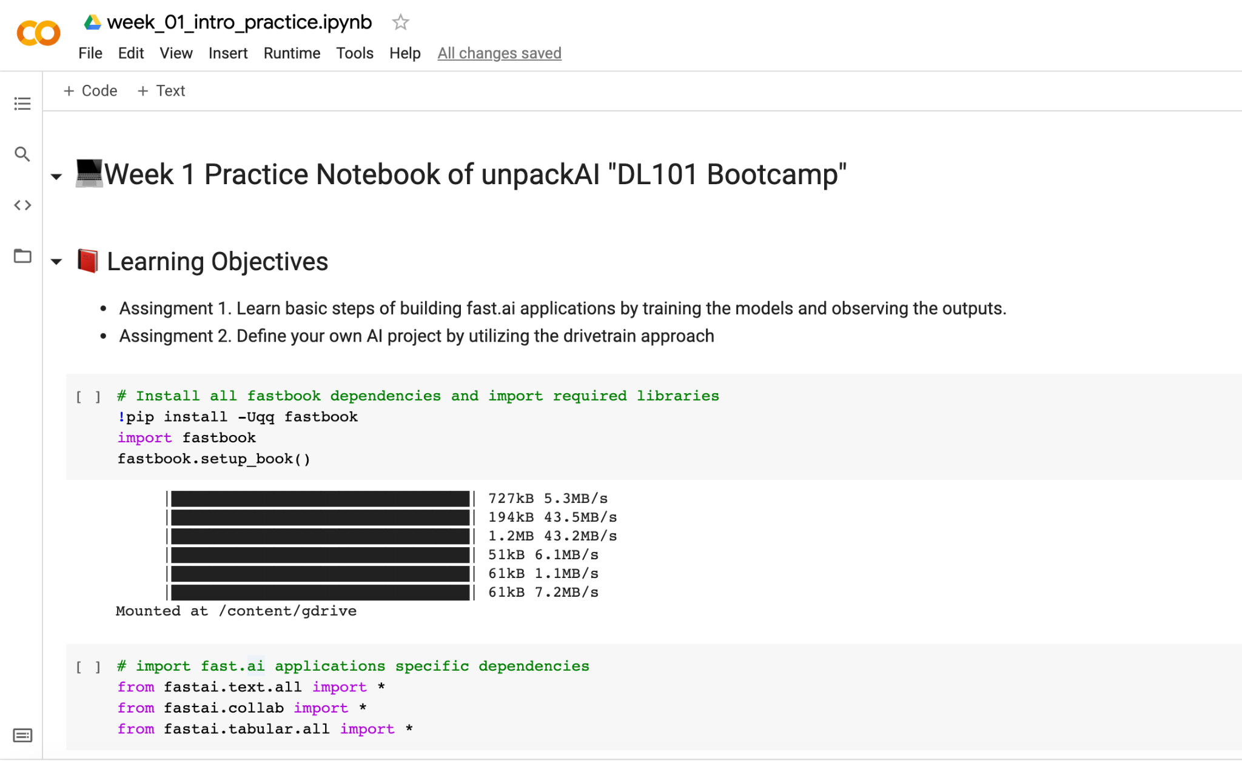
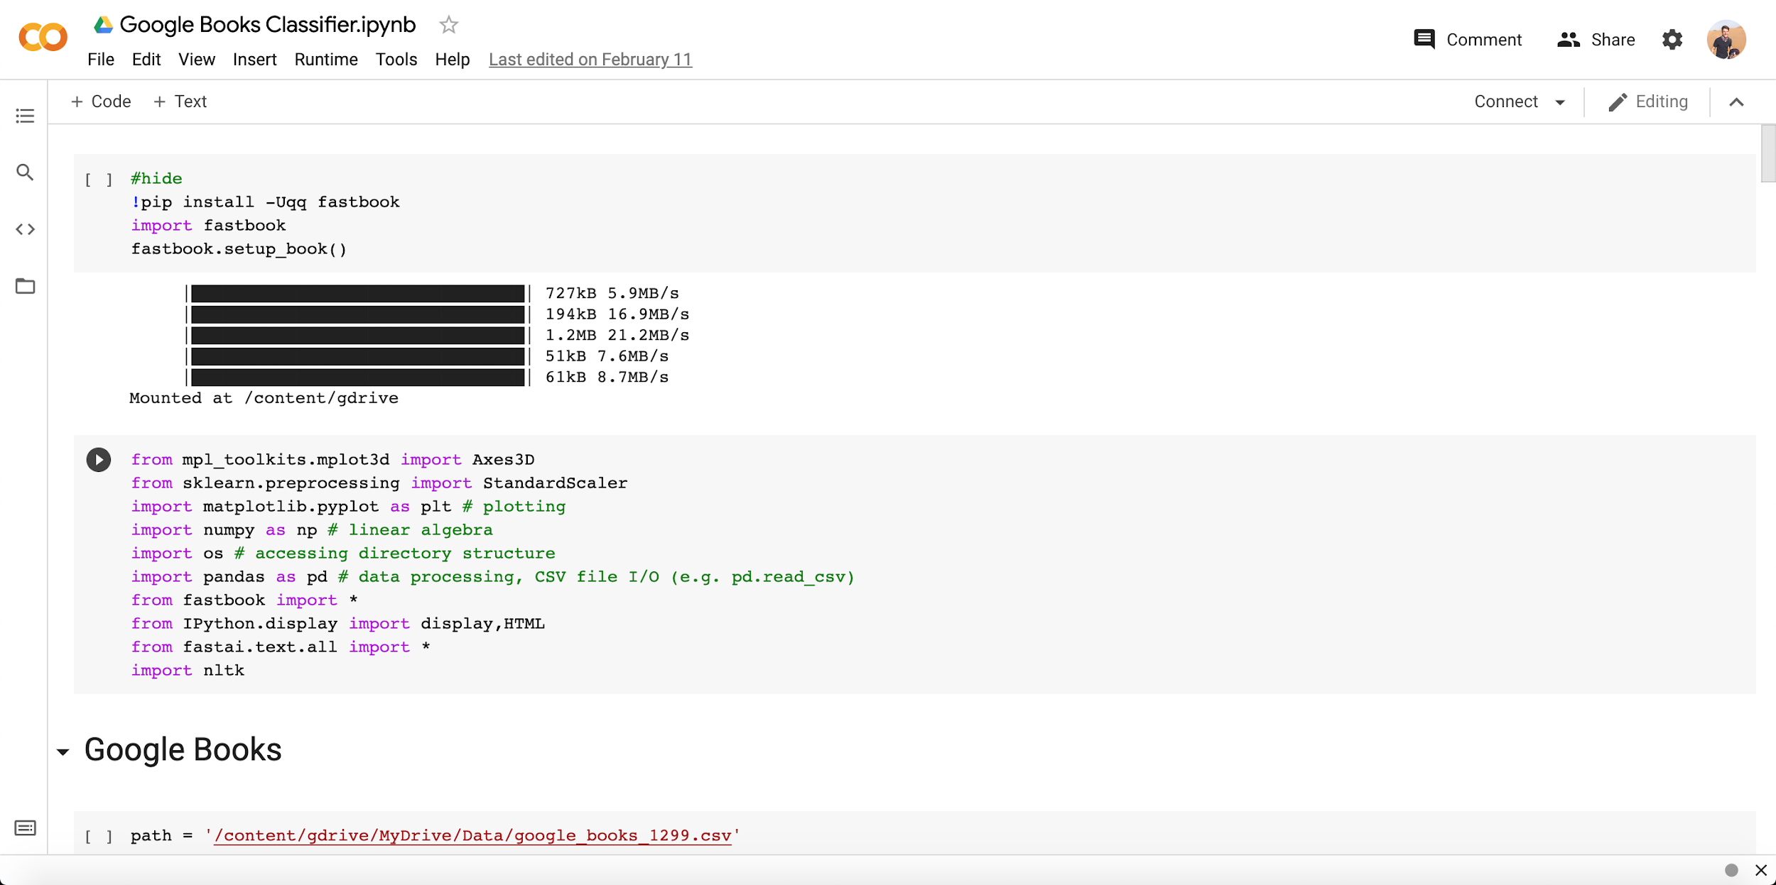
What we expect:
Active Participation ---> Ask Questions!
Attendance ---> Join the Presentation and Review sessions.
Finish Coursebook ---> before Sunday Session (recommended).
Finish Workbook ---> the day before Presentation Session
Coursebook
Workbook

Slide 21
Whats next?

Slide 22
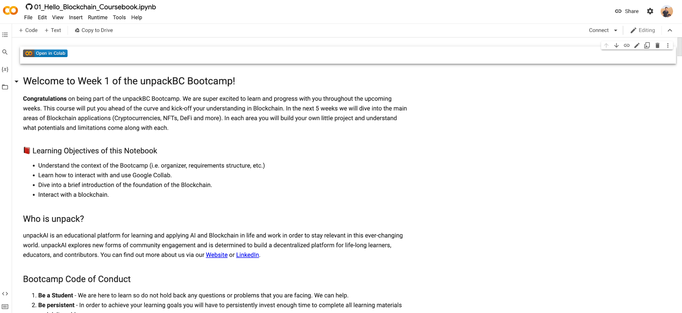
Link: https://colab.research.google.com/github/unpackAI/BL101/blob/main/course_notebooks/Week_1_Hello_Blockchain/01_Hello_Blockchain_Coursebook.ipynb

Slide 23
Thanks for joining!

